Slide 1
Impact of Big Data Analytics on Operational Efficiency in SMEs

Slide 2
Introduction
Small and medium-sized enterprises (SMEs) are vital to global economic growth but often face challenges like limited resources and operational inefficiencies. The rise of Big Data Analytics offers transformative potential by enabling SMEs to gain insights from vast, diverse data sources—such as social media, IoT devices, and customer interactions—to improve decision-making, reduce costs, personalize marketing, and enhance operational efficiency. Technologies like predictive analytics, AI, and cloud computing allow SMEs to overcome barriers like lack of skilled staff or infrastructure, while real-time analytics helps them optimize inventory, manage risks, and improve customer satisfaction. Despite challenges such as data privacy, funding, and digital readiness, SMEs can adopt Big Data successfully through phased implementation, partnerships, and government support. Real-world applications in manufacturing, retail, healthcare, and logistics show that Big Data is not limited to large corporations. With advances in AI, machine learning, and data visualization, the future holds great promise for SMEs to compete effectively and innovate continuously in a data-driven economy.

Slide 3
NEED OF THE STUDY
The study on the impact of Big Data Analytics on operational efficiency in SMEs is
essential because SMEs face challenges in optimizing their limited resources and
staying competitive. Big Data Analytics offers powerful tools to enhance decision-
making and streamline operations, which can significantly improve productivity.
Understanding its impact helps SMEs adopt data-driven strategies effectively.
Additionally, this study highlights the barriers SMEs face in implementing analytics
and explores solutions to overcome them. Ultimately, it aims to support SMEs in
leveraging technology for sustainable growth and efficiency.

Slide 4
SCOPE OF THE STUDY
The scope of this study covers the examination of how Big Data Analytics influences
operational efficiency specifically within Small and Medium Enterprises (SMEs). It focuses
on various sectors where SMEs operate, such as manufacturing, retail, and services, to
understand diverse applications. The study explores both the benefits and challenges faced
by SMEs in adopting Big Data Analytics. It also considers technological, organizational,
and financial factors affecting implementation. Overall, the study aims to provide insights
that can guide SMEs in effectively leveraging Big Data for improved operations.

Slide 5
OBJECTIVIES OF THE STUDY
1.To analyze how Big Data Analytics enhances operational efficiency in SMEs.
2. To identify the key challenges SMEs face in adopting Big Data Analytics.
3. To evaluate the impact of Big Data-driven decision-making on SME productivity and competitiveness.
4. To explore the role of technology infrastructure and skills in successful Big Data Analytics implementation in SMEs.
5. To provide recommendations for SMEs to effectively leverage Big Data Analytics for sustainable growth.

Slide 6
Research Methodology
• Descriptive design using primary and secondary data.
• Primary: Questionnaires and interviews with SME owners.
• Secondary: Journals, reports, case studies.
• Analysis: Descriptive statistics and thematic analysis

Slide 7
LIMITATIONS OF THE STUDY
1. The study may be limited by the sample size and geographic scope, which could affect the generalizability of the findings to all SMEs.
2. Respondents’ understanding of Big Data Analytics concepts may vary, potentially influencing the accuracy of the collected data.
3. Limited access to SMEs that have fully adopted Big Data Analytics might restrict the depth of analysis on advanced usage and outcomes.
4. Rapid technological changes may make some findings less relevant over time as new tools and practices emerge.
5. Data privacy and confidentiality concerns may limit the willingness of some SMEs to share detailed operational and analytics information.

Slide 8
Theoretical Framework
The theoretical framework for analyzing the impact of Big Data Analytics (BDA) on SME productivity integrates concepts from Information Systems (IS) theory, Resource-Based View (RBV), Dynamic Capabilities, Technology Acceptance Model (TAM), and others to explain how data-driven tools transform operations. IS theory views BDA as a strategic system enhancing coordination and efficiency; RBV sees it as a valuable, rare resource enabling competitive advantage; and Dynamic Capabilities emphasize SMEs’ ability to adapt quickly using real-time insights. TAM explains adoption based on perceived usefulness and ease of use, especially vital for SMEs with limited tech expertise. Supporting theories like Lean Management, Information Management, and Diffusion of Innovations highlight how BDA improves operational efficiency, knowledge sharing, waste reduction, and innovation adoption. The socio-technical systems perspective underscores the need to align technology use with organizational culture, skills, and change management. Finally, successful BDA implementation depends on SME readiness, leadership support, data quality, and responsiveness to a dynamic market, making this framework a comprehensive lens for understanding how BDA enhances SME operations.

Slide 9
Company Profile – Tech Mahindra
Tech Mahindra Ltd., headquartered in Pune, India, is a leading multinational IT services and consulting company, originally established in 1986 as a joint venture between Mahindra & Mahindra and British Telecom. Renamed in 2006, the company now operates in over 90 countries with more than 148,000 employees as of March 2025, offering a broad range of services including digital transformation, IT consulting, cloud solutions, AI, ML, IoT, blockchain, and big data analytics across sectors like telecom, healthcare, banking, retail, and manufacturing. Guided by the "Rise" philosophy, its mission emphasizes empowerment through technology, customer-centricity, innovation, and sustainability. The company’s evolution includes its IPO in 2006, acquisition of Satyam in 2013, and significant expansion in emerging technologies during the 2020s. Recent initiatives include launching ESG risk platforms, partnering with AWS, and focusing on AI for local languages through The Indus Project. Despite a temporary dip in Q3FY2024 earnings, Tech Mahindra continues to lead with strategic leadership changes and new product offerings. Its services cover IT infrastructure, enterprise solutions, engineering, BPS, telecom networks, and industry-specific solutions in finance, healthcare, retail, and automotive. Recognized for its CSR programs like SMART and ARISE, Tech Mahindra has received multiple awards for social impact. The company also maintains key subsidiaries across sectors such as automotive, finance, real estate, tourism, and logistics, reinforcing its diversified presence in the Mahindra Group.

Slide 10
Applications of Big Data in SMEs
Predictive Maintenance in Manufacturing Using sensor data and analytics to predict equipment failures and schedule maintenance before breakdowns occur, reducing downtime and costs.
Demand Forecasting in Retail Analyzing historical sales data, seasonal trends, and customer behavior to accurately forecast product
demand, improving inventory management.
Route Optimization in Logistics Leveraging GPS and traffic data to identify the most efficient delivery routes, saving time and fuel, and increasing on-time deliveries.
Personalized Marketing in Services Using customer data and behavior patterns to tailor marketing messages and offers, enhancing engagement and boosting conversion rates.

Slide 11
Key Findings
Big Data Analytics (BDA) adoption in SMEs:
65% of SMEs already use BDA, and 20% plan to implement it soon.
Main benefits reported include:
Faster and more informed decision-making
Supply chain optimization
Cost savings and efficiency gains
Major challenges faced by SMEs in adopting BDA:
High implementation and operational costs
Shortage of skilled professionals
Poor data quality
Resistance to change within the organization

Slide 12
Data Analysis Summary
Performance outcomes and usage patterns of Big Data Analytics (BDA) in SMEs:
80% of SMEs reported operational improvements after adopting BDA.
50% achieved cost reductions of more than 10%.
The most commonly used analytics types are predictive and descriptive analytics.
IT departments are primarily responsible for handling BDA within SMEs.

Slide 13
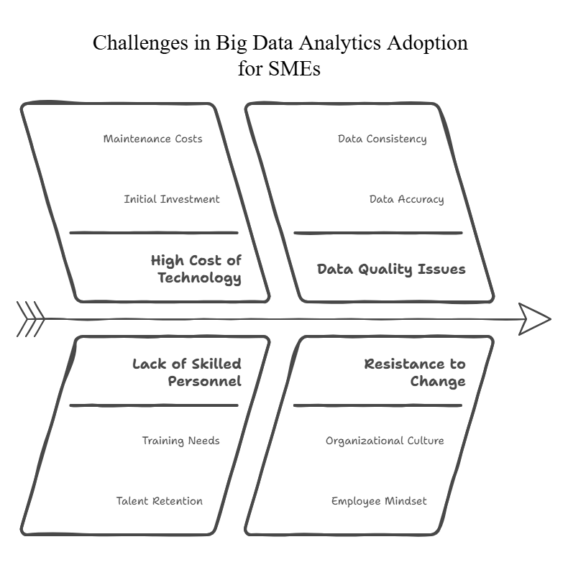

Slide 14
Recommendations
Big Data Analytics in SMEs: Overview, Impact, and Recommendations Big Data Analytics (BDA) is increasingly transforming the operations of Small and Medium Enterprises (SMEs), with 65% already using BDA and 20% planning implementation. Key applications include predictive maintenance in manufacturing, demand forecasting in retail, route optimization in logistics, and personalized marketing in services. The main benefits reported are faster decision-making, optimized supply chains, and significant cost savings, with 80% of SMEs noting operational improvements and 50% achieving over 10% cost reductions. Despite this, challenges like high costs, skill shortages, poor data quality, and resistance to change persist. Most SMEs use predictive and descriptive analytics, with IT departments leading the efforts. To maximize impact, SMEs should begin with pilot projects, leverage cost-efficient cloud-based tools, train staff to foster a data-driven culture, align BDA initiatives with core business goals, and continuously measure return on investment (ROI).

Slide 15
Conclusion
Big Data Analytics (BDA) has become a vital tool for enhancing efficiency, competitiveness, and decision-making in Small and Medium Enterprises (SMEs). With 65% of SMEs already adopting BDA and 20% planning to do so, applications such as predictive maintenance, demand forecasting, logistics optimization, and personalized marketing are driving significant improvements. Around 80% of SMEs report enhanced operations, and 50% have achieved cost reductions over 10%. Despite challenges like high costs, limited skills, data quality concerns, and change resistance, SMEs primarily rely on their IT departments to manage predictive and descriptive analytics. Success depends on leadership support, staff training, the adoption of easy-to-use, cloud-based tools, and fostering a strong data-driven culture. Strategic alignment with business goals and consistent ROI tracking are key to sustaining long-term value from BDA.

Slide 16
Thank You
Prepared by: P.MANIKANTH
HT. No :123161011
Project: Impact of Big Data Analytics on Operational Efficiency in SMEs

